Slide 1
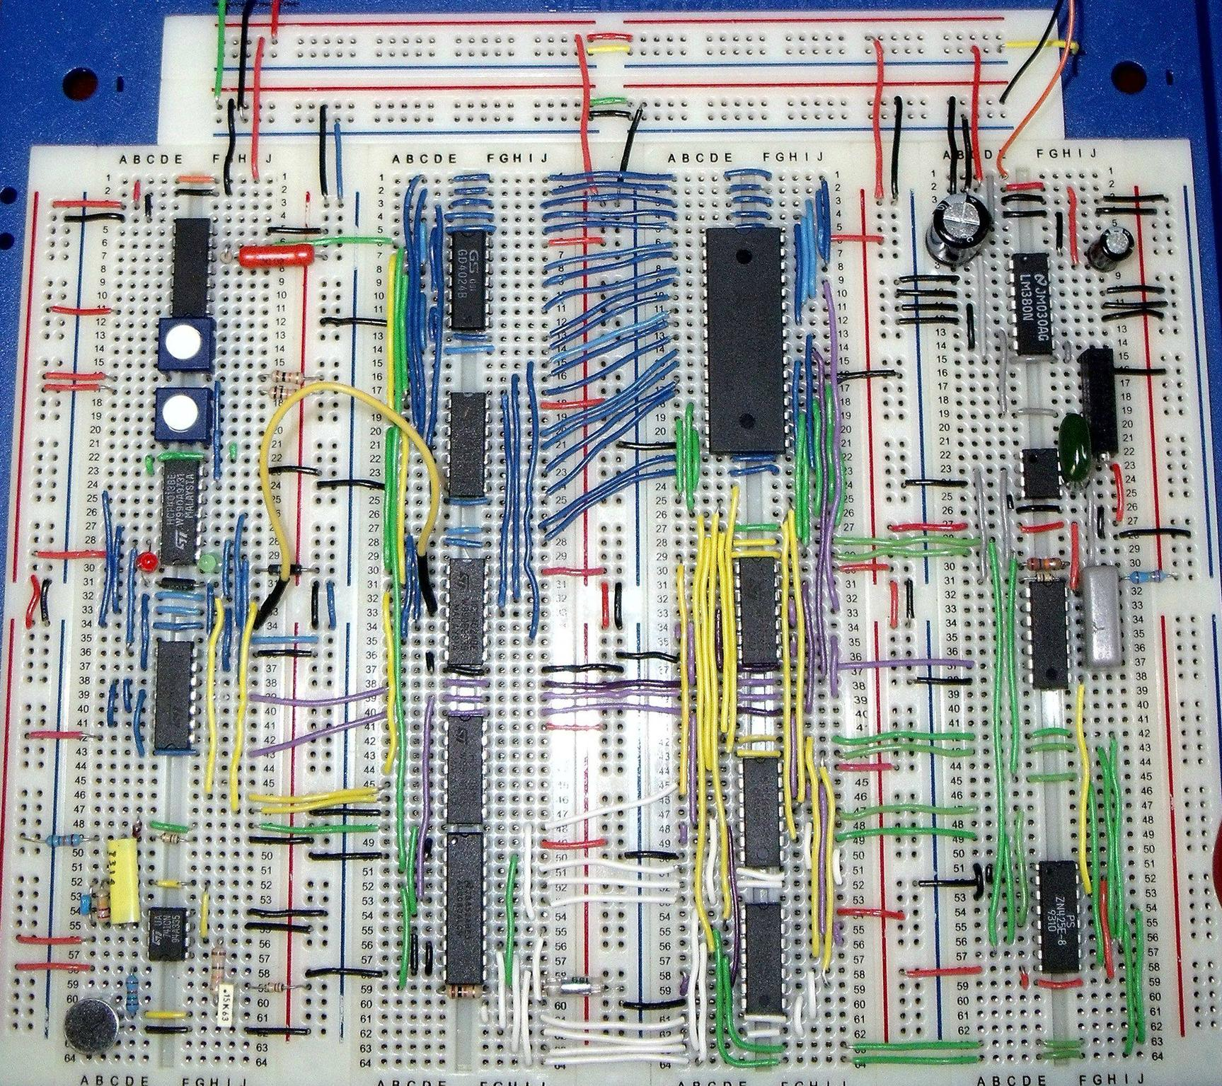
Virtual Workshop 1
Voltage Dividers and Breadboards
Led by Ethan Tabler
Committee Members
Jack Supenia
Will McGloughlin
Kan Nsekhe
Nish Pagarani
Penn State IEEE
Workshop 1
September 3, 2020

Slide 2
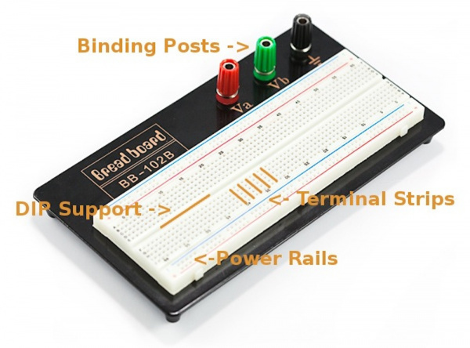
Why Use Breadboards?
Solderless
Ideal for prototyping
Great for trying out new components
Perfect for IEEE workshops!
PSU IEEE Workshop 1

Slide 3
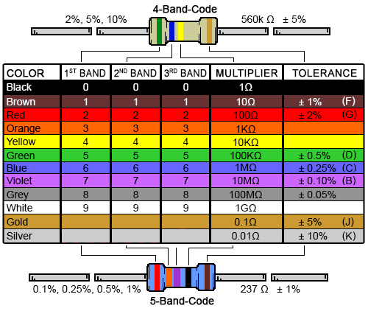
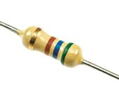
Resistors
For DIYers, there are three important resistor specs:
Resistance Value
Power Rating
Tolerance
Use the colored bands to determine the resistance and tolerance!
PSU IEEE Workshop 1

Slide 4
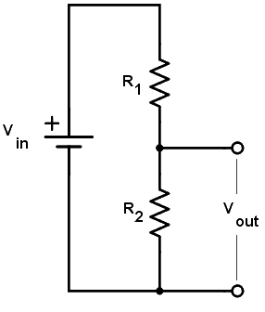
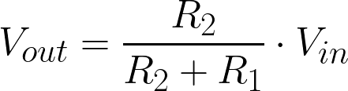
Voltage Dividers
What are they?
Takes in an input voltage
Drops input voltage by a certain amount
Drop based on the values of the resistors in the network
When picking resistor values, consider the load on the output
PSU IEEE Workshop 1

Slide 5
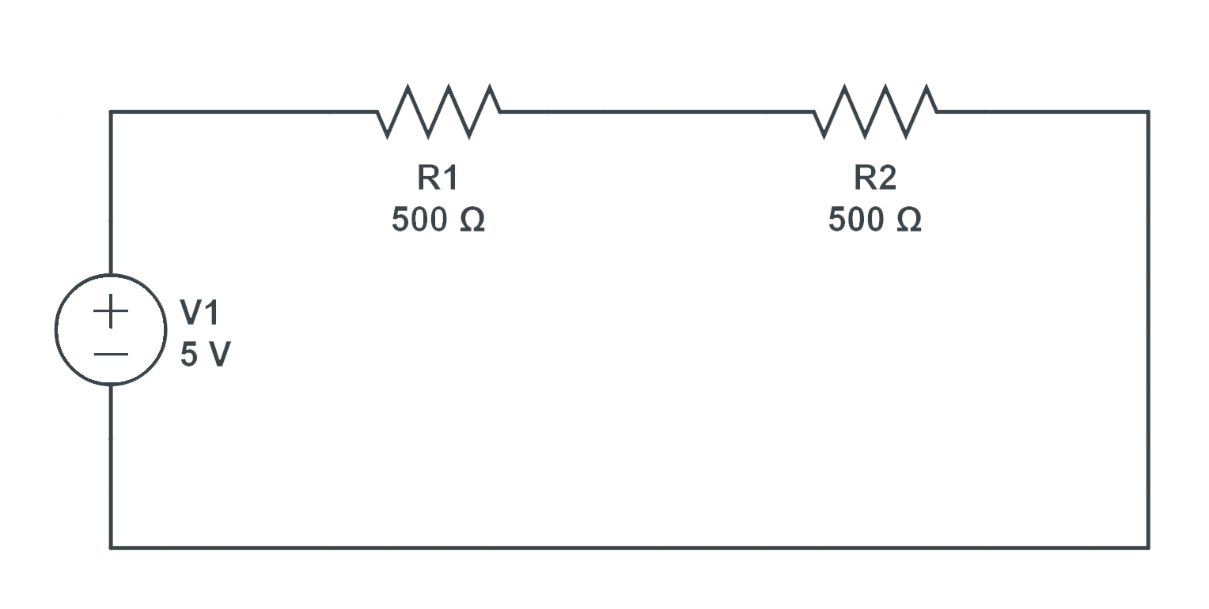
An Example:
PSU IEEE Workshop 1

Slide 6
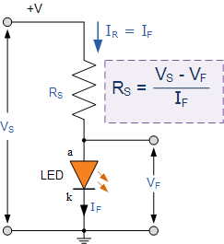
Circuit Diagram
PSU IEEE Workshop 1

